Slide 1
Analytics 2021 Face Comparison Hackathon
Aayush Shah - 190100003
Ashutosh Sharma - 190100027
Satdhruti Paul - 190100105

Slide 2
Our Model And Understanding
The problem statement requires us to compare two faces and output if they contain the same person or not.
We employed 2 set of convolution layers with batch normalizations, pooling and dense networks, similar to the FaceNet Model but with additional depth.
We achieve 87% accuracy on training data and 60% accuracy on validation split with 2 out of 10 epochs run.

Slide 3
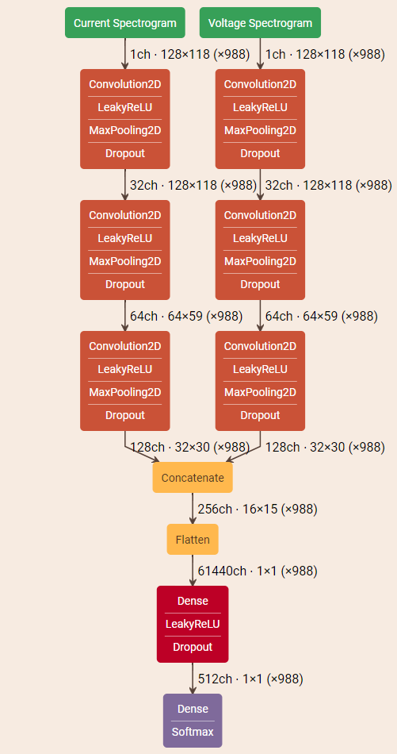
Further Improvements
We have made excess convolution 2d layers which can be reduced and instead we had planned to adopt an approach similar to this (image on right).
Concatenation of similar convolution pathways and then a final conv, relu and softmax layer to get 0/1 output.
More Epochs could’ve been run but we were short on time so we ran 1-2 epochs out of 10 and got 60% accuracy on the validation data split.

